Slide 1
LEARNING PYTHON

Slide 2
CONTEXT:
WHAT IS PYTHON?
PYTHON JOBS
WHY TO LEARN PYTHON?
PYTHON ONLINE/INTERPRETER
GOOGLE COLAB
MY PYTHON CODE

Slide 3
What is Python?
Python is a well-liked general-purpose programming language that has a broad range of uses. High-level data structures, dynamic typing, dynamic binding, and many other features make it equally useful for scripting or "glue code" that ties components together as they do for developing complex applications. Additionally, it can be enhanced to execute C or C++ code and make system calls to almost all operating systems. Python is a universal language used in a wide range of applications because of its ubiquity and capacity to run on almost every system architecture.
A well-liked programming language is Python. In 1991, Guido van Rossum produced it, and it became available.
It's employed for:
website creation (server-side),
software creation,
mathematics,
scripting for systems.

Slide 4
PYTHON JOBS
The demand for talented Python programmers to create websites, software components, and applications, as well as to work with Data Science, AI, and ML technologies, is at an all-time high right now. All the major corporations are actively seeking out these programmers. In 2022, while we are creating this lesson, there is a severe lack of Python programmers, despite the market's demand for more of them because of Python's use in machine learning, artificial intelligence, and other fields.
Python is currently the most expensive programming language in America, with a 3-5 year expertise level requiring a $150,000 annual salary. Nevertheless, it may change depending on where the Job is located. To name just a few significant businesses that use Python would be impossible.

Slide 5
WHY TO LEARN PYTHON?
One of the most well-liked programming languages in the world is routinely regarded as Python. Python is quite simple to learn, so if you're just getting started with learning a programming language, Python can be a perfect option. Python is now being taught as the main programming language at many different schools, colleges, and universities. Python is the programming language of choice for most developers for a number of other strong reasons, including the fact that it is open source and thus cost-free to use. Python is straightforward and incredibly simple to learn. It is also adaptable and can be used to develop a wide variety of things. AI, ML, and other strong development libraries are available in Python. Python is highly sought-after and guarantees a good compensation.

Slide 6
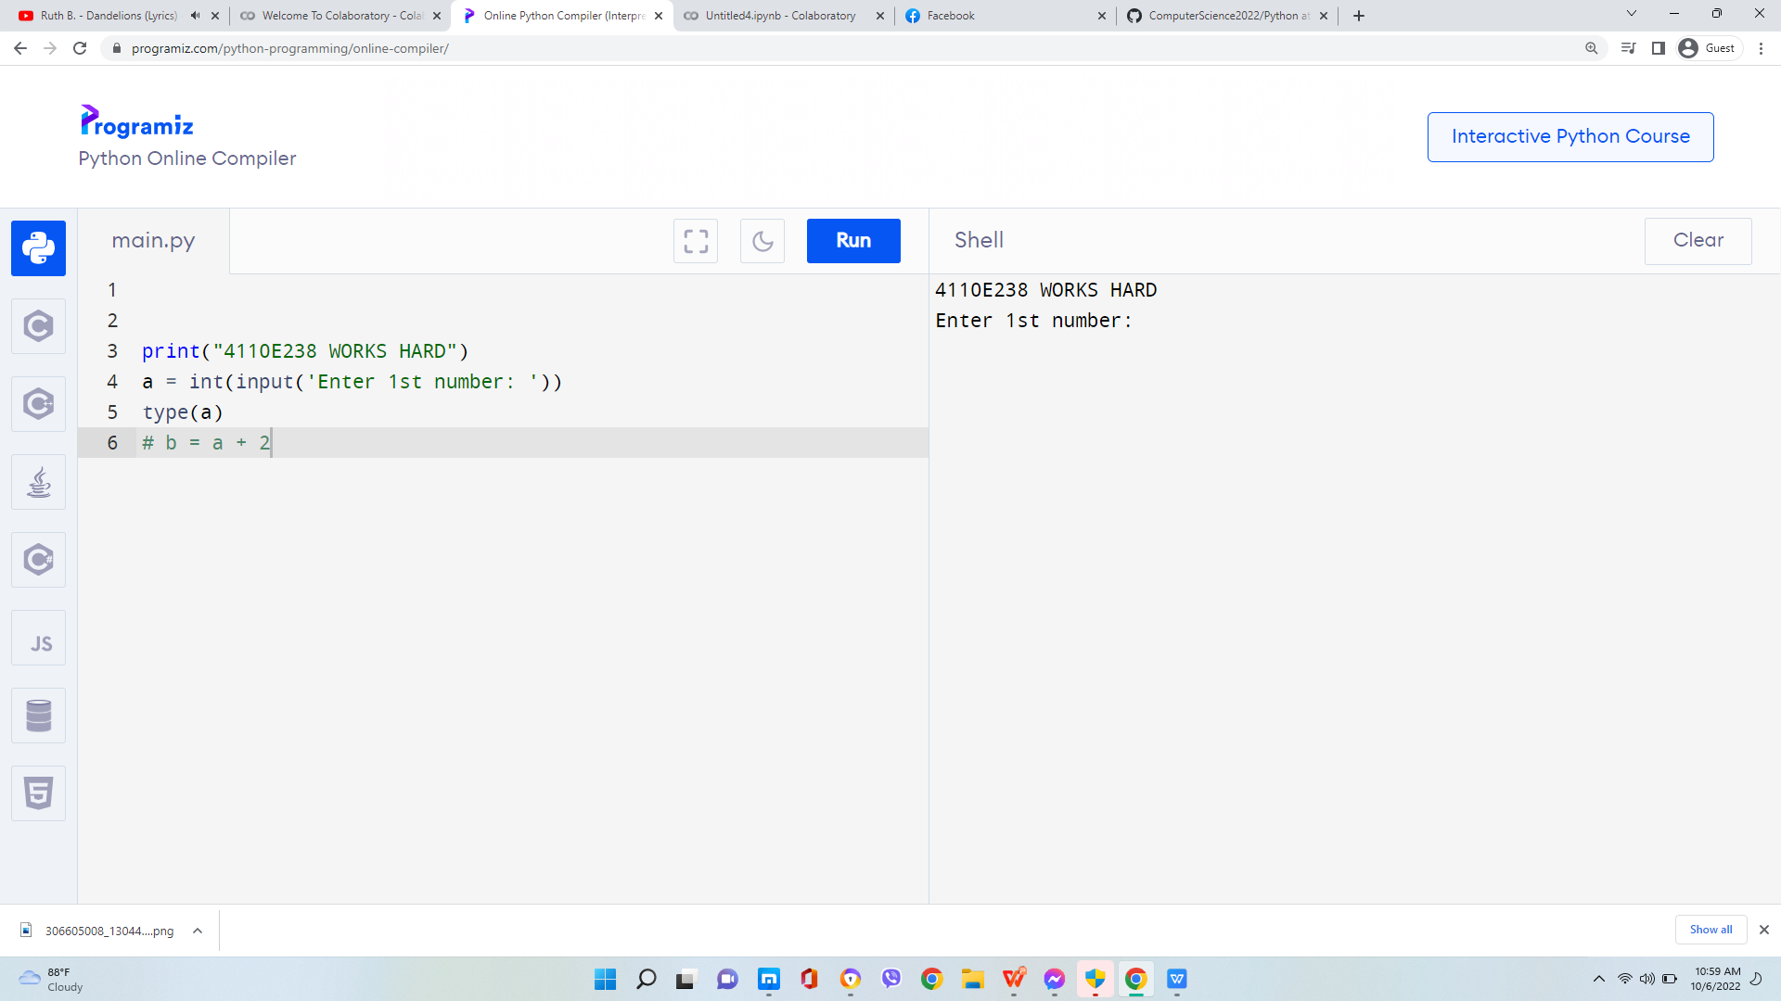
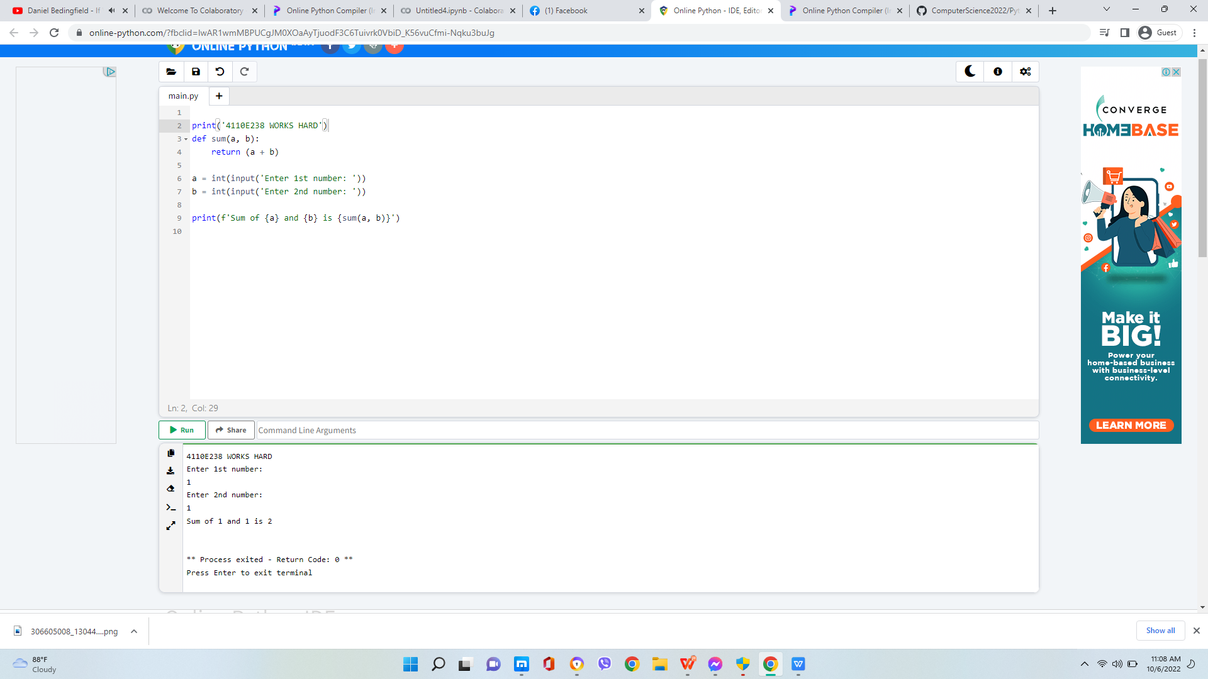
PYTHON ONLINE/INTERPRETER

Slide 7
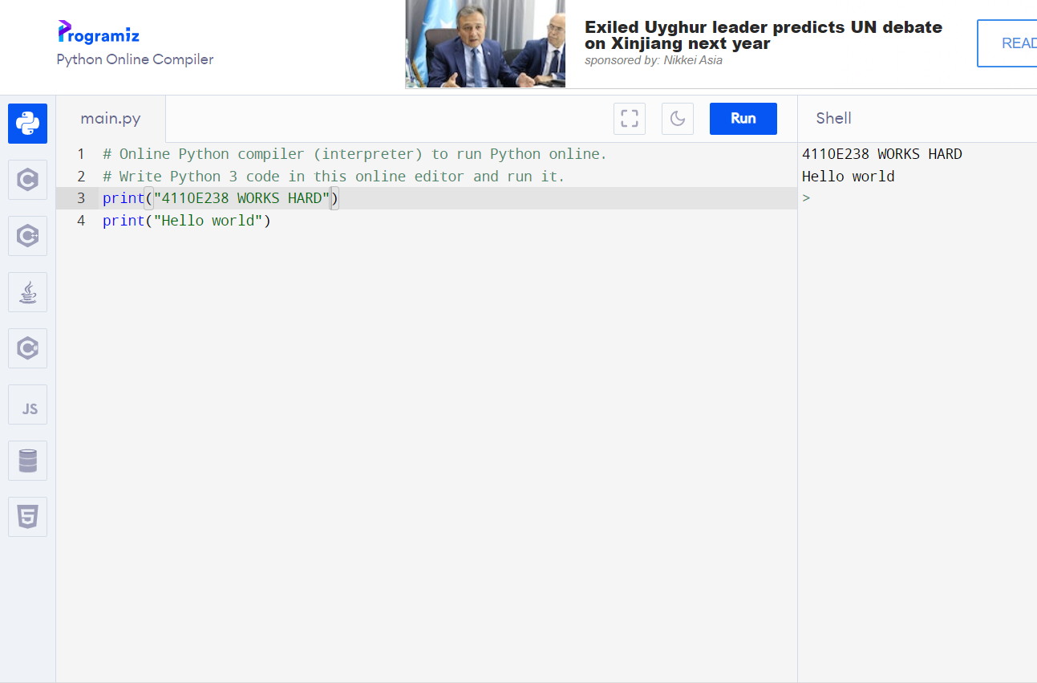
PYTHON ONLINE INTERPRETER: 2

Slide 8
INPUT AND OUTPUT

Slide 9
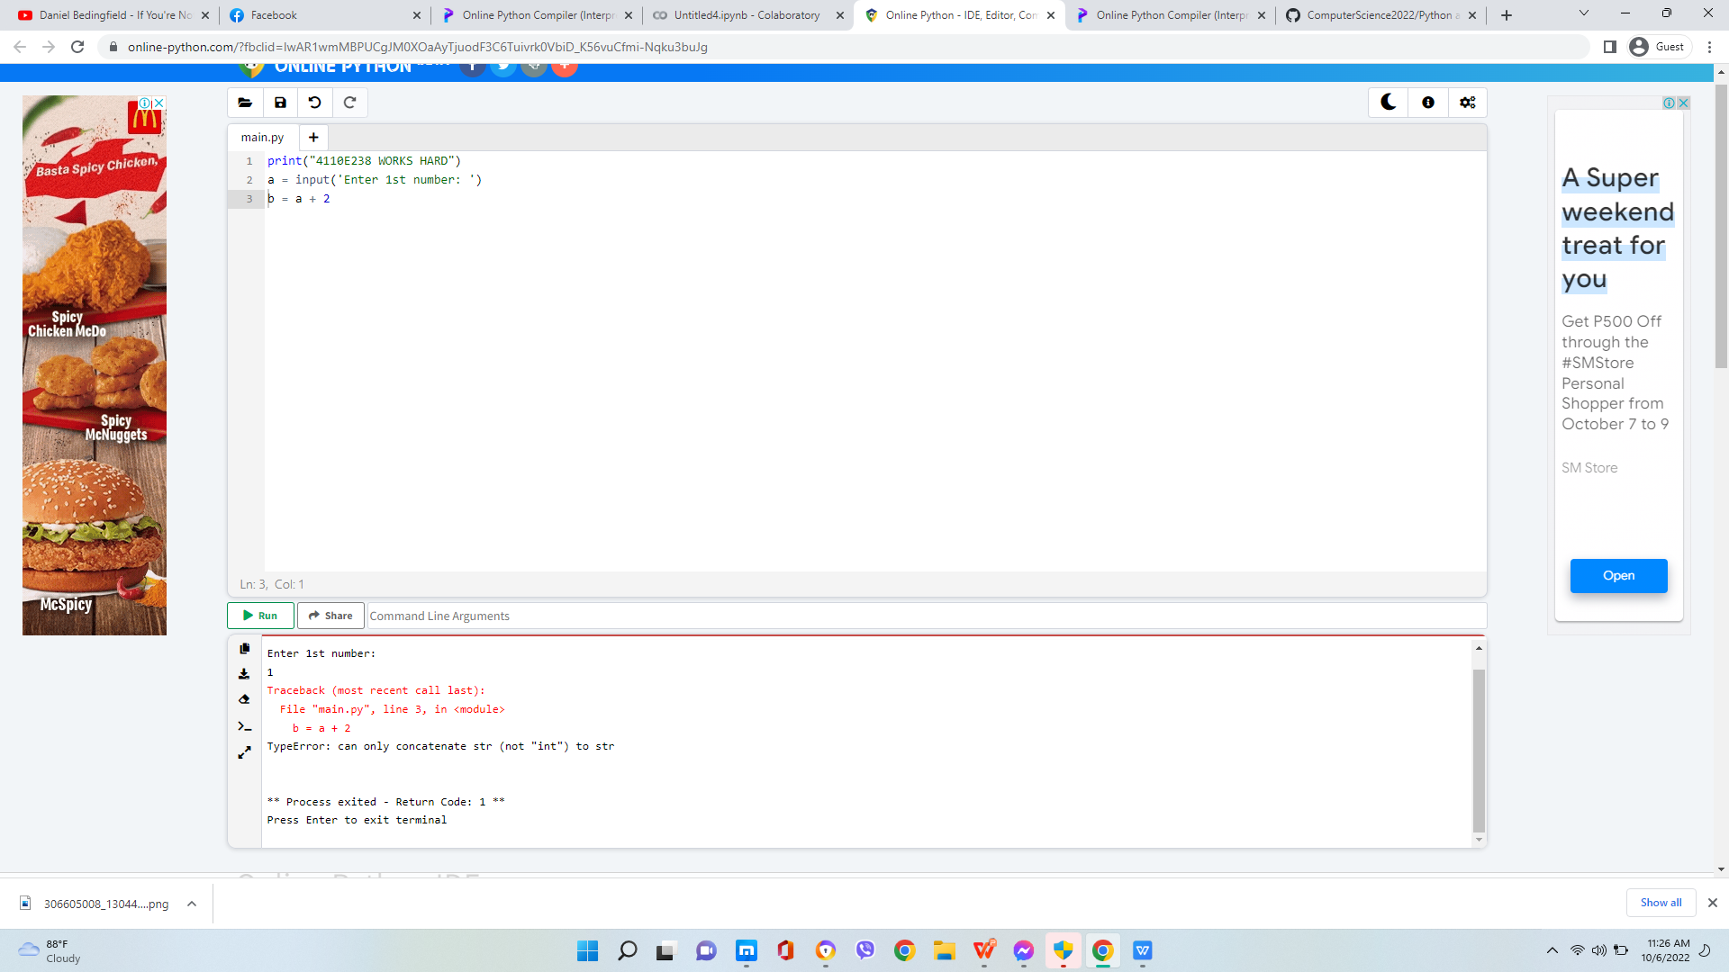
QUESTION:

Slide 10
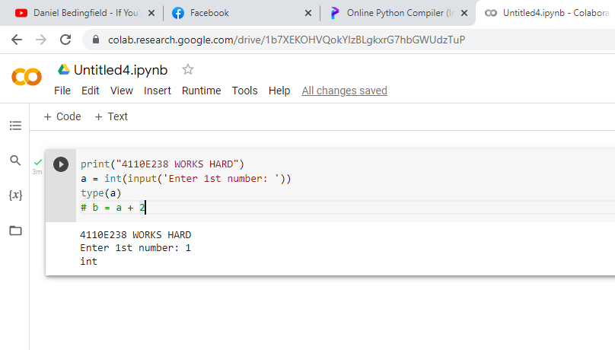
WAY : 1

Slide 11
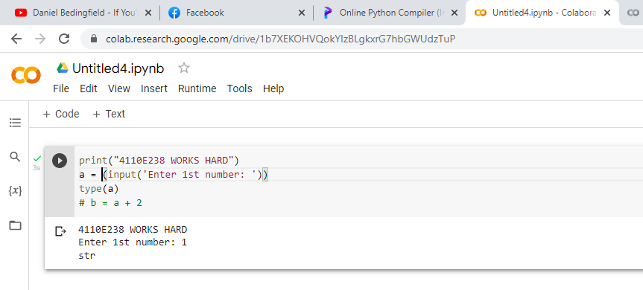
WAY : 2

Slide 12
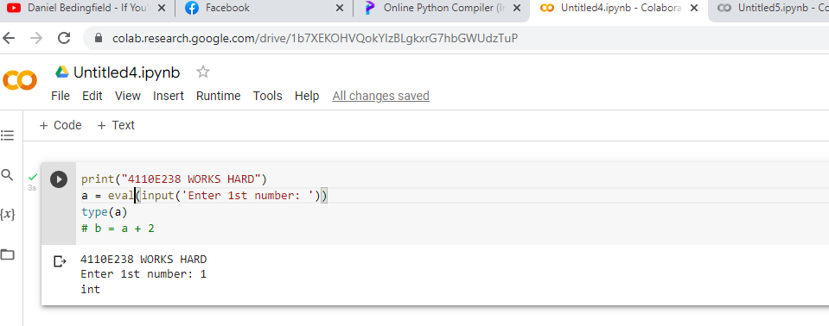
WAY : 3

Slide 13
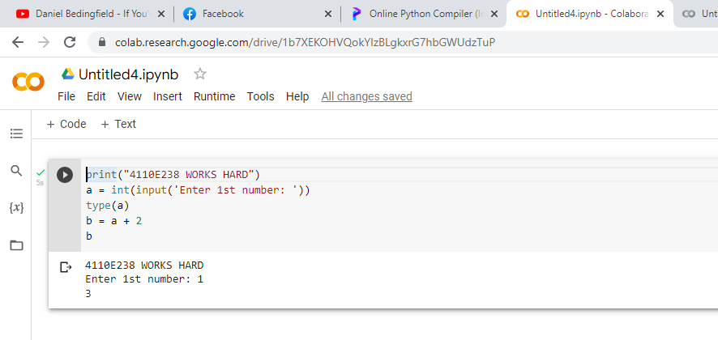
ANSWER: 1

Slide 14
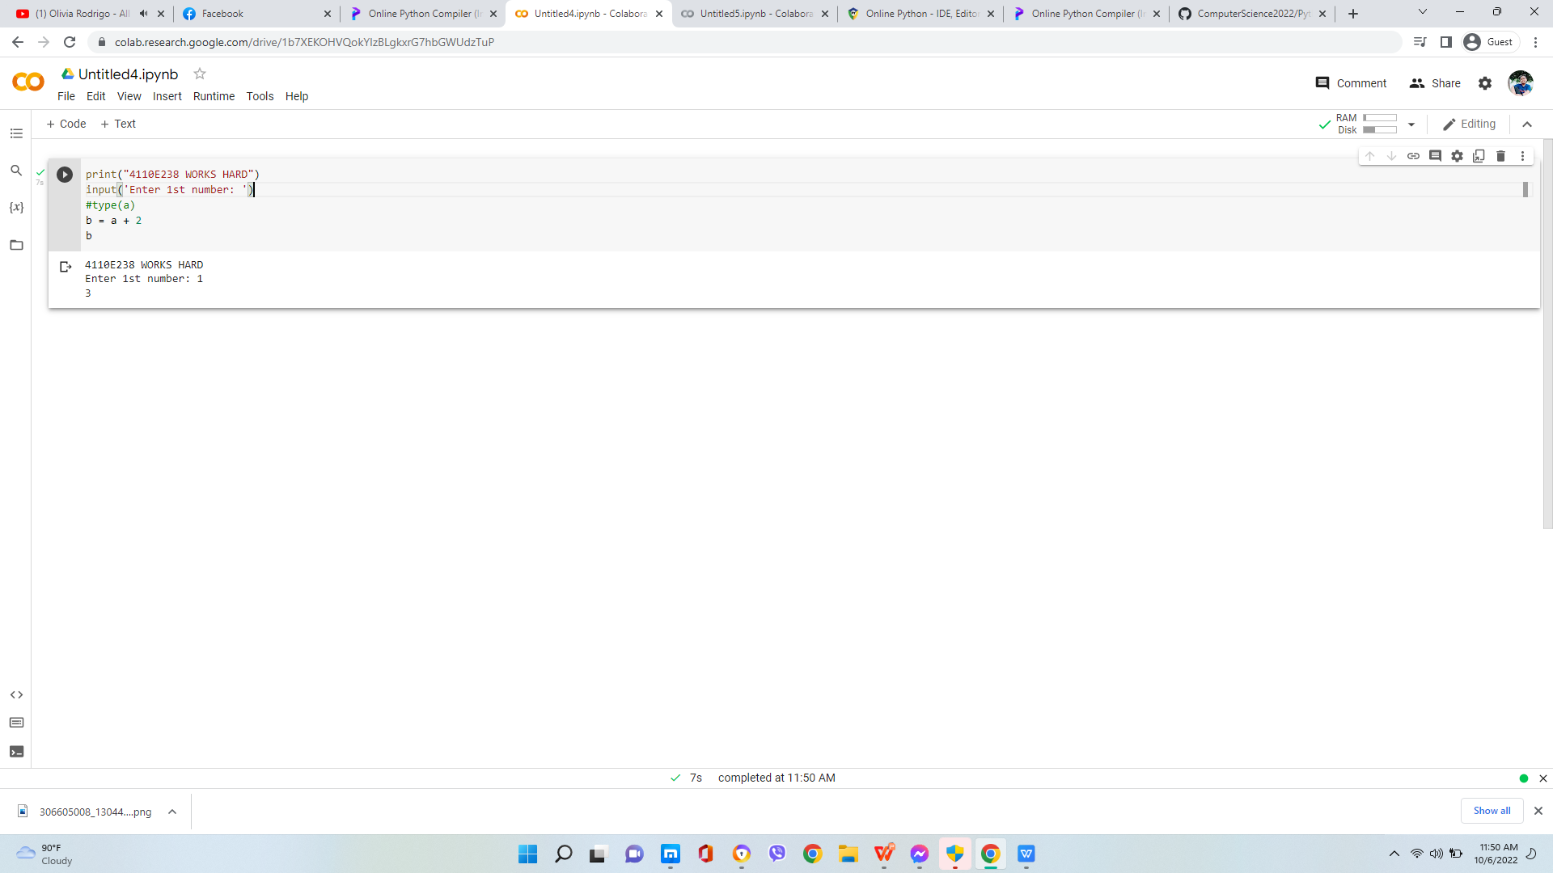
ANSWER: 2

Slide 15
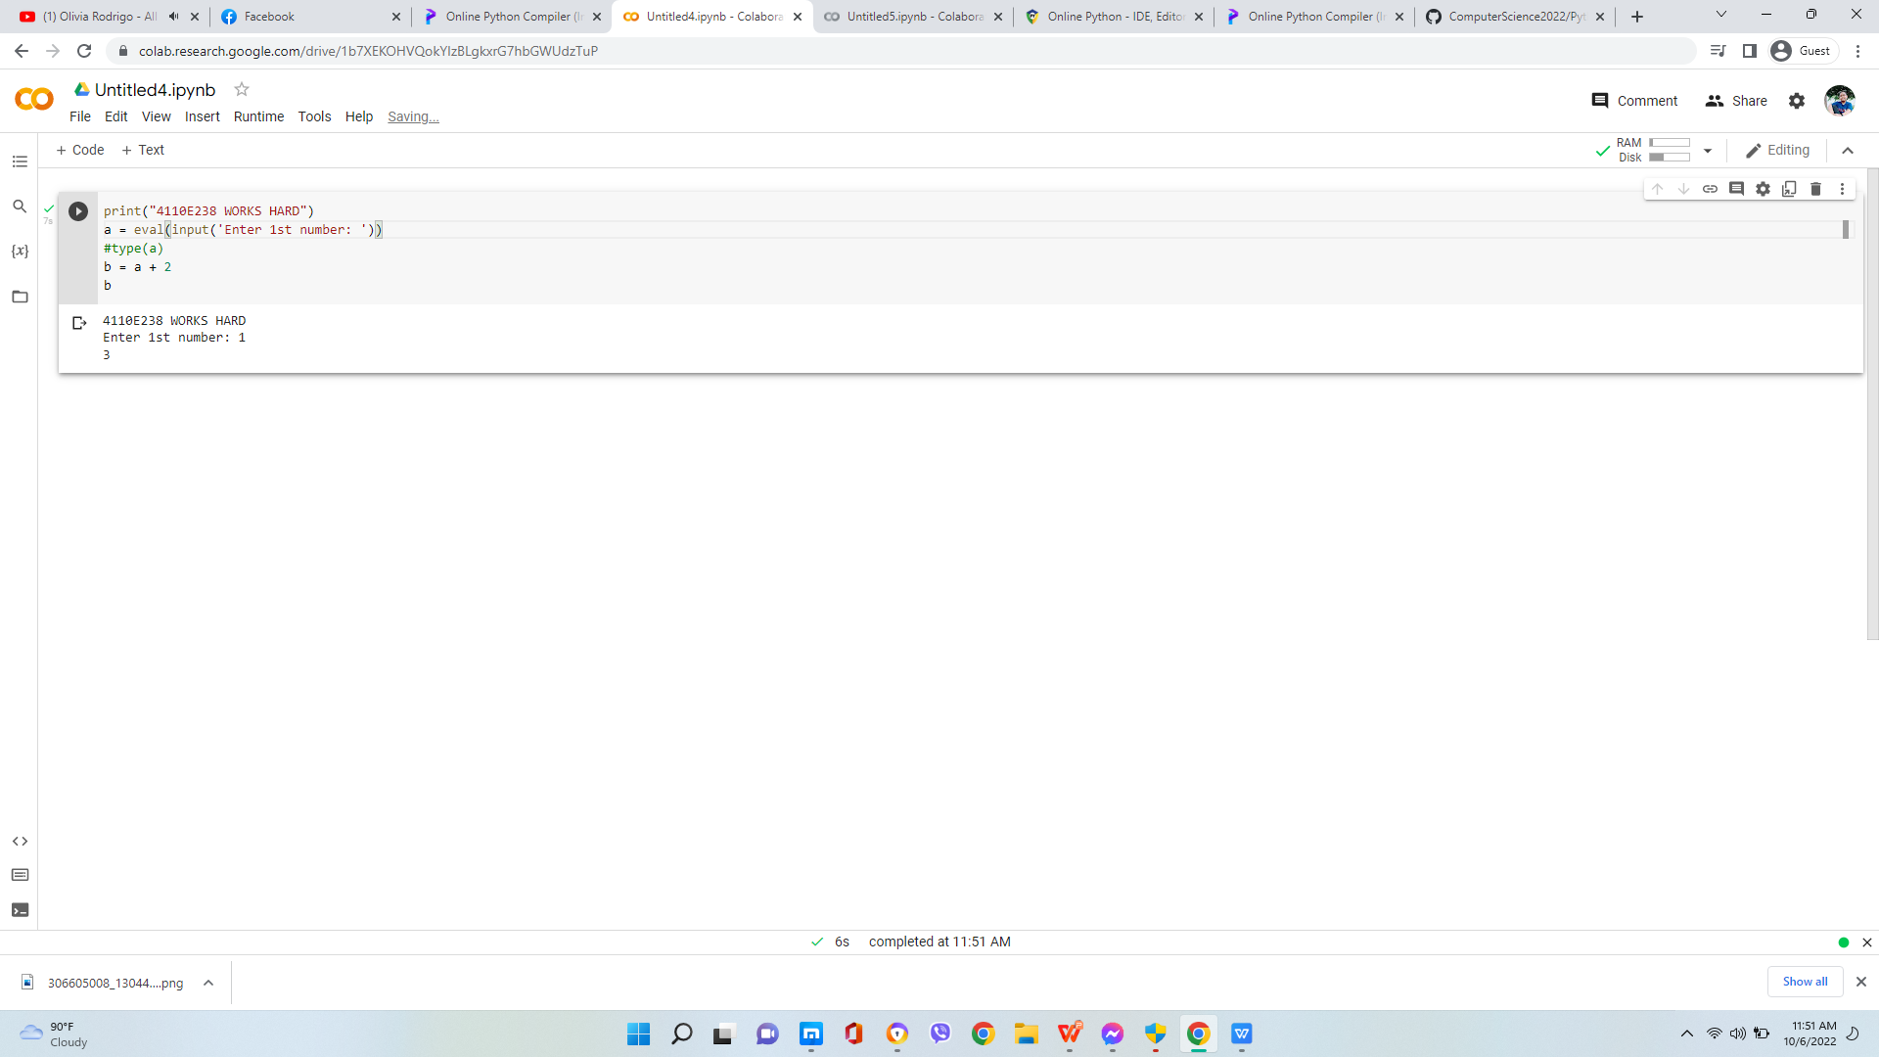
ANSWER: 3

Slide 16
PYTHON DATA TYPES

Slide 17
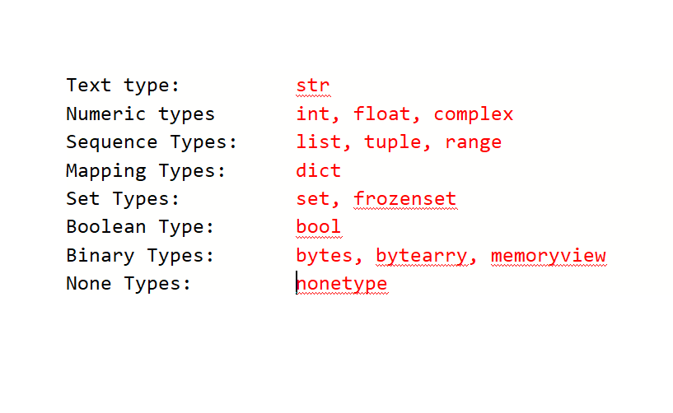
DATA TYPES

Slide 18
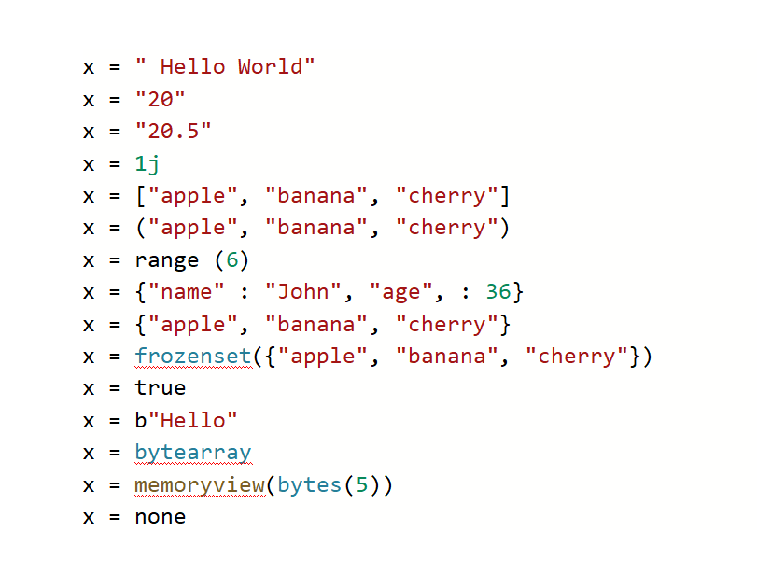
SETTING THE SPECIFIC DATA TYPE

Slide 19
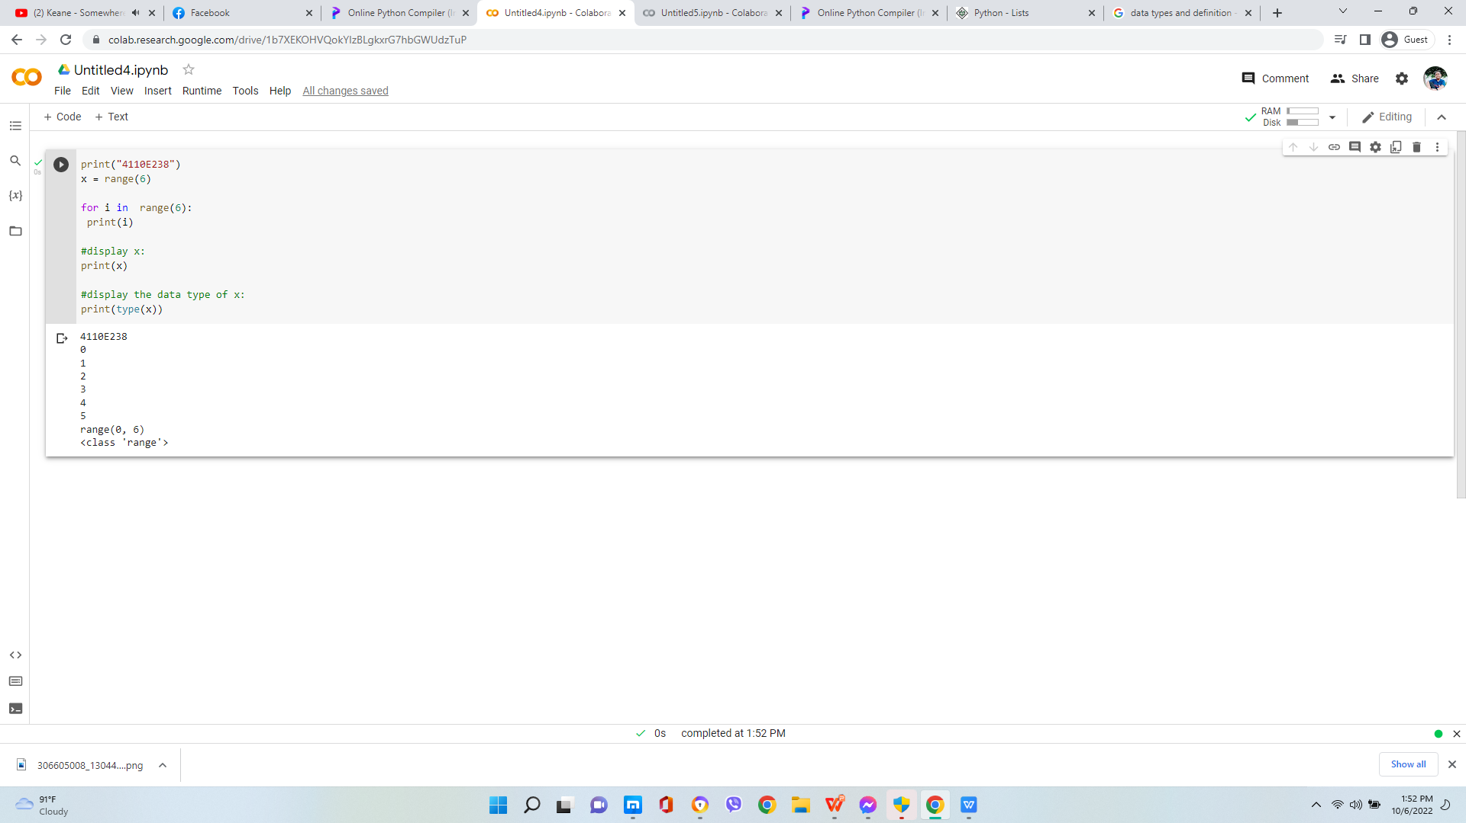

PYTHON DATA

Slide 20
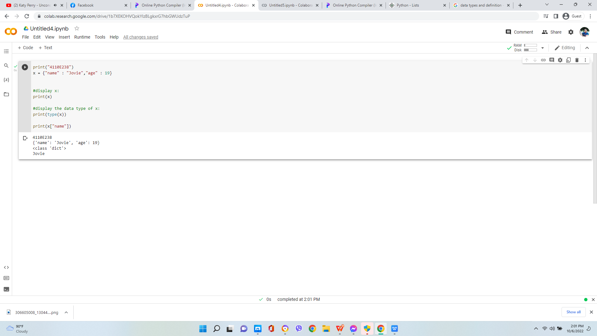
dict: key-value pair

Slide 21
PYTHON OPERATORS

Slide 22
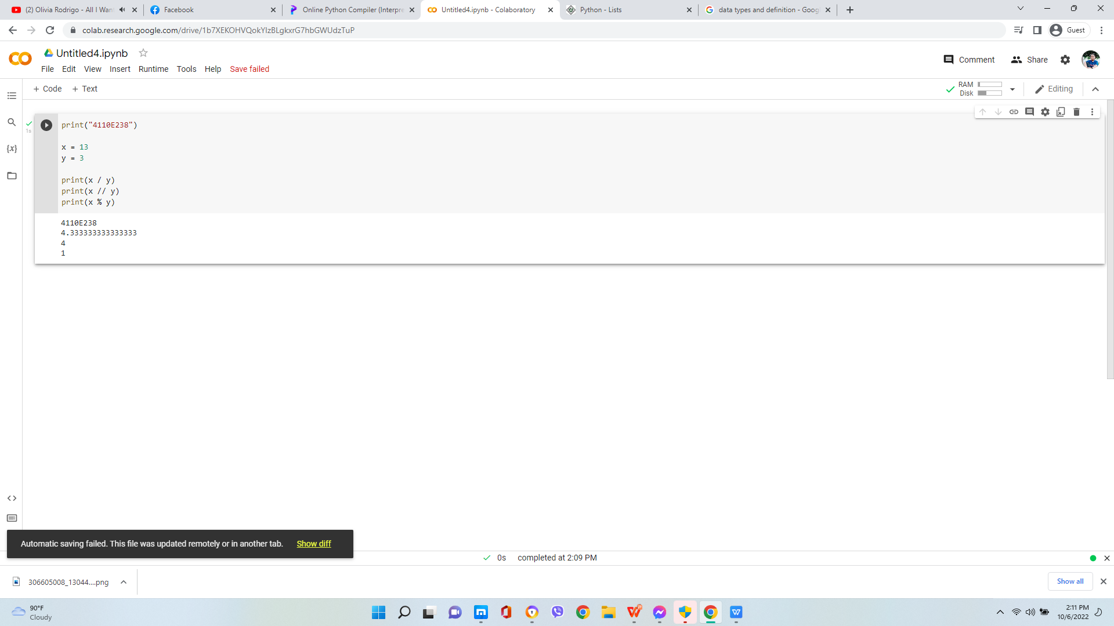
PYTHON ARITHMETIC OPERATORS

Slide 23
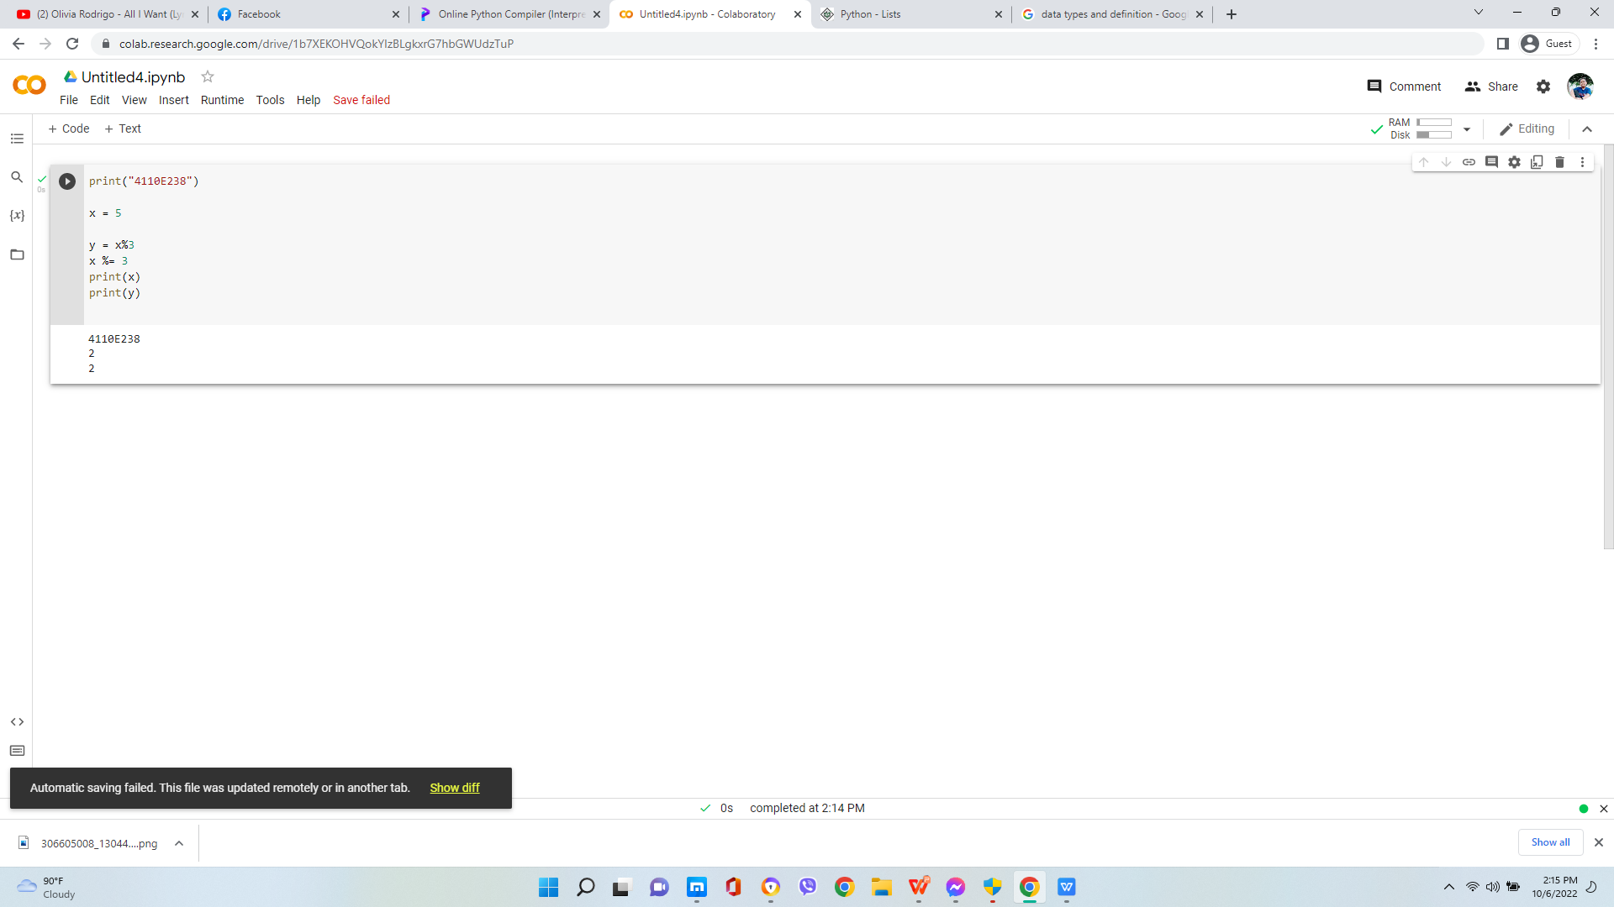
PYTHON ASSIGNMENT OPERATORS

Slide 24
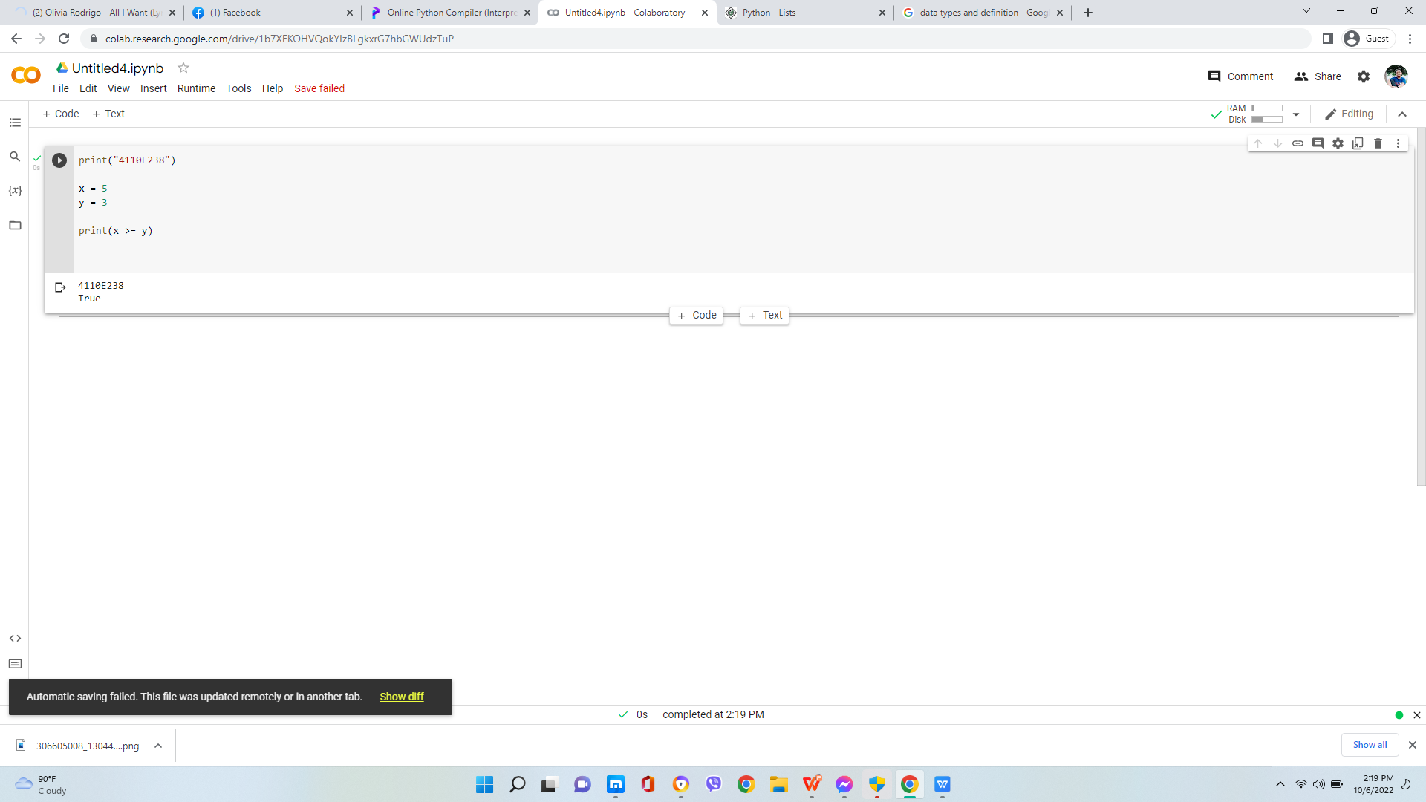
PYTHON COMPARISON OPERATORS

Slide 25
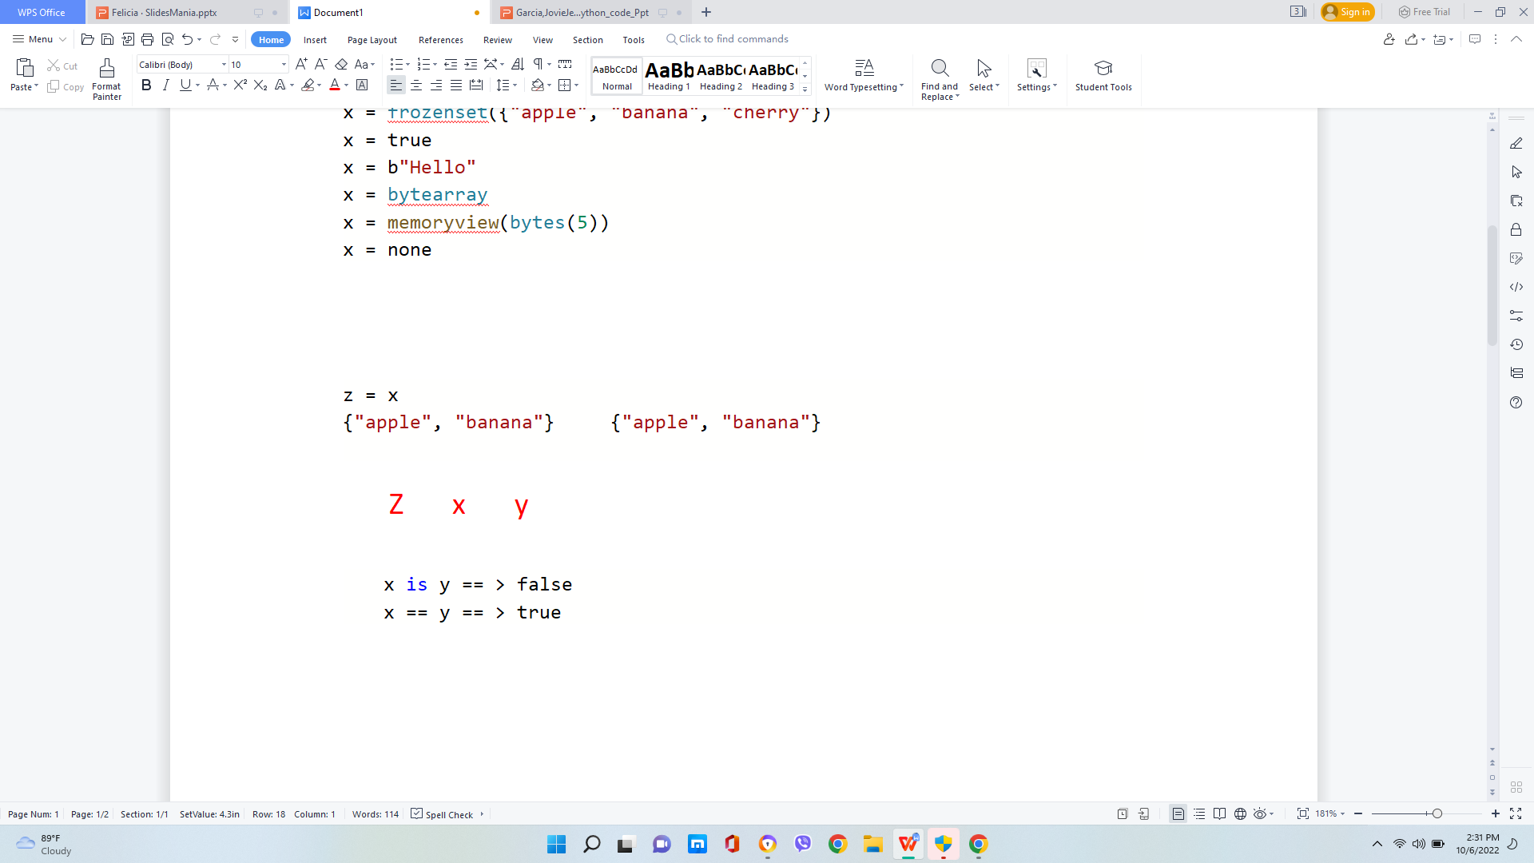
PYTHON COMPARISON OPERATORS

Slide 26
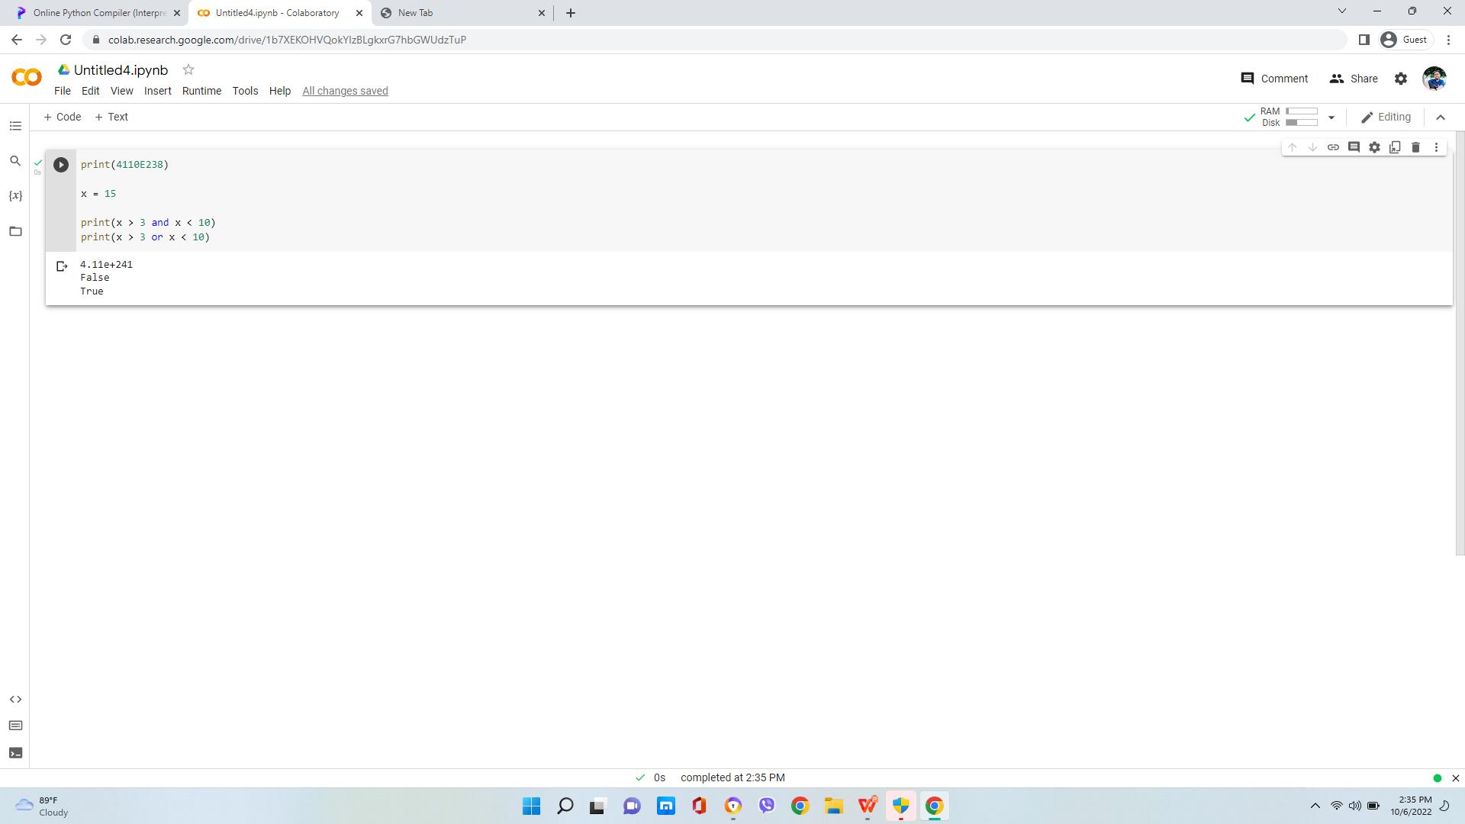
PYTHON LOGICAL OPERATORS

Slide 27
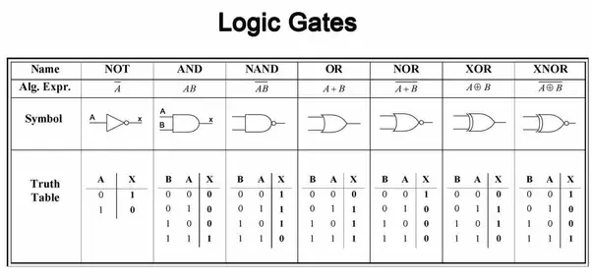
PYTHON LOGIC GATE

Slide 28
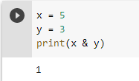
PYTHON BITEWISE OPERATORS
binary
1*22*+0*21+1*20
(101)2
(011)2
(001)2

Slide 29
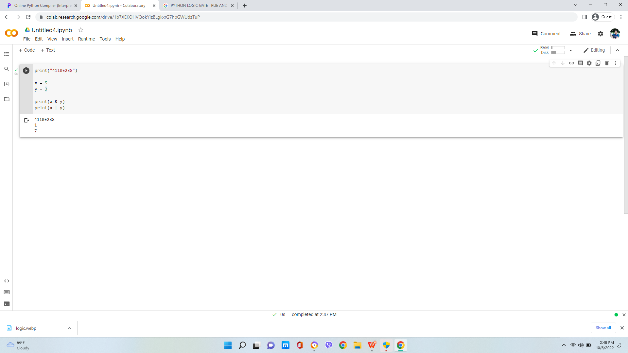
PYTHON BITEWISE OPERATORS

Slide 30
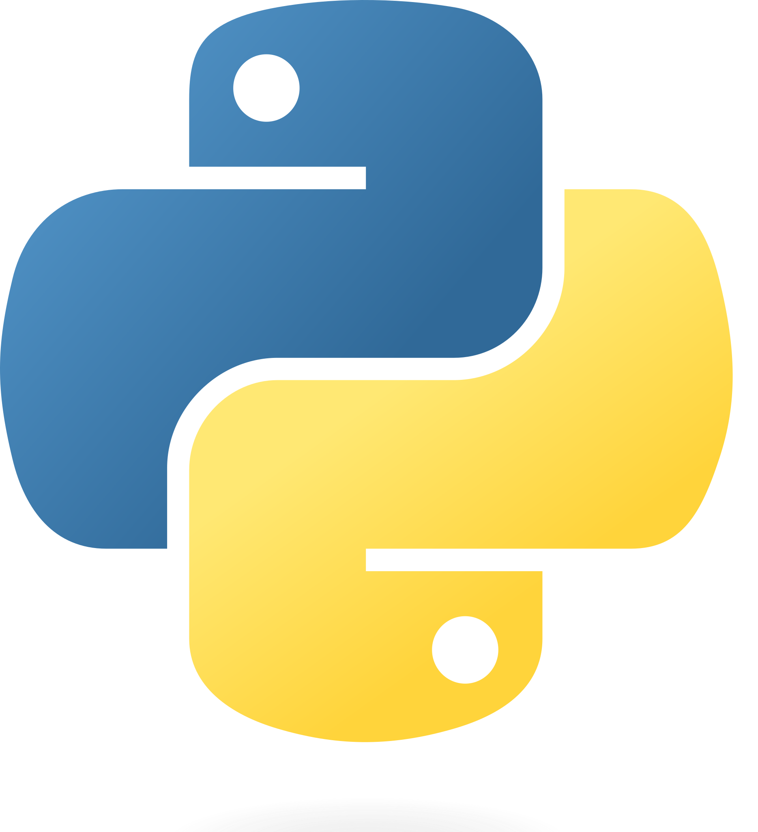
Chinese name: 珍古絲汀
Student ID: 4110E238
English name: Jovie Jean A. Garcia
Nickname: Jovie
Email:joviegarcia92@gmail.com
GITHUB:https://github.com/4110E238/cs2022.gitV
PYTHON

